Slide 1



From CREX to CEνNS:
The Weak Radius of ⁴⁰Ar
冯仟潞

Slide 2



目录
Contents
01
02
03
04
the CREX-PREX dilemma
Covariant density functional theory
Results
Conclusion
Notes:
幻灯片制作：中山大学党委宣传部 陈柏辰
幻灯片内置的所有示例图片、手绘建筑元素版权归中山大学党委宣传部和供稿人所有，不得移作他用。

Slide 3
SYSU 2023
PRESENTATION SLIDE
01
the CREX-PREX dilemma

Slide 4
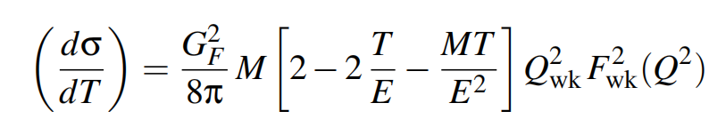
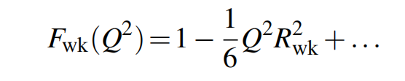
the weak redius of ⁴⁰Ar
Because of the broad application of CEvNS (nuclear structure, fundamental symmetries, dark matter searches and so on), it is imperative to nuclear-structure uncertainties associated with the weak form
factor of the target nucleus.
（1）
（2）
use a set of accurately calibrated covariant energy density functionals to predict the weak radius of ⁴⁰Ar.
the differences of these models: isovecor section (due to the scarcity of nuclear observables with large neutron-proton asymmetries.)
the slope of the symmetry energy
isovector section
the neutron skin
the weak radius

Slide 5
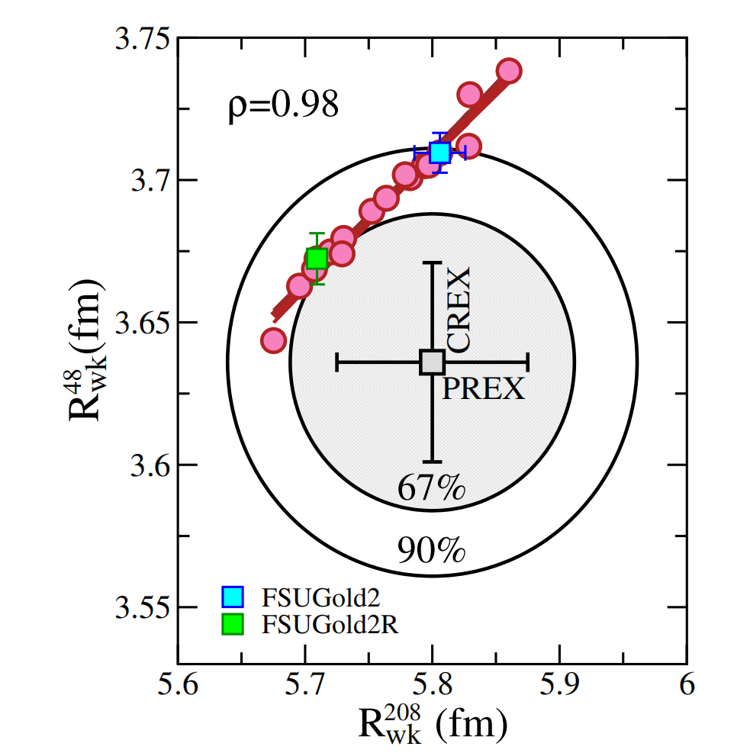
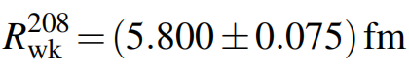
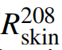
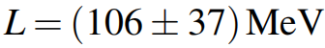
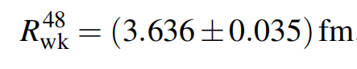
the CREX-PREX dilemma
two experiment using parity-violating electron scattering to measure the weak radius: PREX and CREX
PREX: ²⁰⁸Pb
through the correlation between the weak radius ( ) and the slope of the symmetry energy at saturation density (L).
CREX: ⁴⁸Ca
Under the assumption that the neutron skin depends on the slope of symmetry energy, there will be a larger weak radius than experiment:

Slide 6
SYSU 2023
PRESENTATION SLIDE
02
Covariant density functional theory

Slide 7
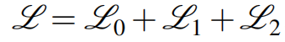
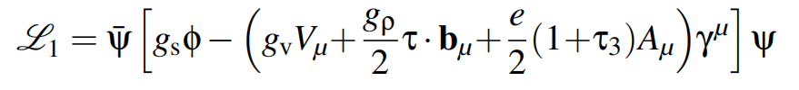

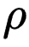
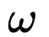
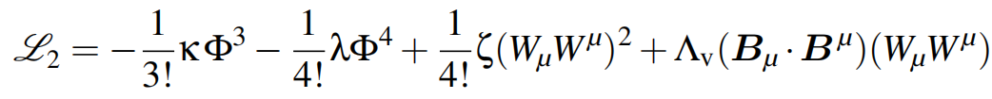
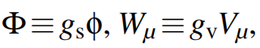
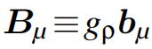
Covariant density functional theory
the adopted version of the 17 covariant energy density functionals:
:non-interacting component, i.e. the kinematic energy of all the constituents.
:the Yukawa couplings between nucleons and mesons.
:the isodoublet nucleon field; :a scalar field ( ); :the isocevtor-vector field ( ); :the vector field ( ).
:meson self-interactions that simulate density-dependent effects.
and .

Slide 8
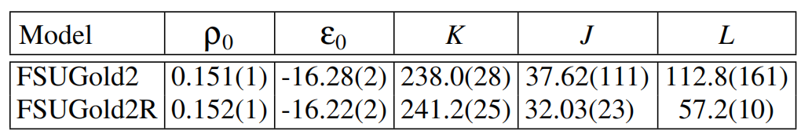

FSUGold2 and FSUGold2R
FSUGold2:
ground-state properties of magic and semi-magic nuclei
centroid energiesof giant monopole resonances
the maximum mass of neutron stars
FSUGold2R:
tidal deformabilities extracted by the LIGO-Virgo collaboration
stellar radii inferred by the NICER mission
the equation of state of pure neutron matter as predicted by chiral effective field theory ( EFT)
+FSUGold2
differences:
Fig2: bulk properties of the finite nuclear matter predicted by FSUGold2 and FSUGold2R respectively.

Slide 9
SYSU 2023
PRESENTATION SLIDE
03
Results
the statistical uncertainties, the systematiac uncertainties and the predicted weak radius of ⁴⁰Ar

Slide 10
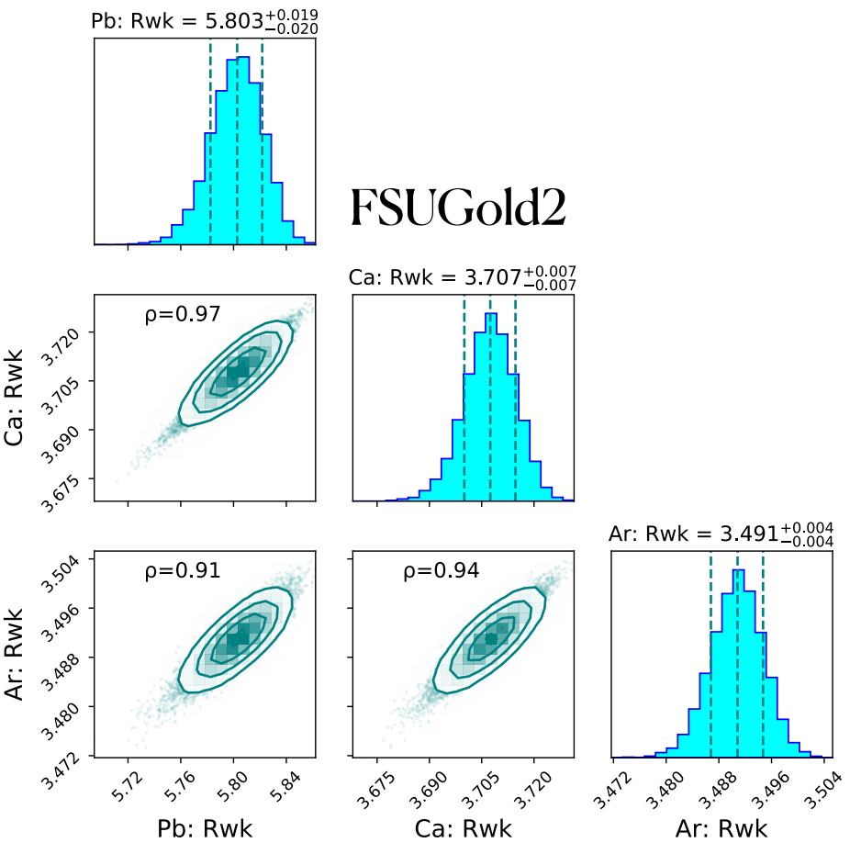
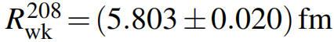
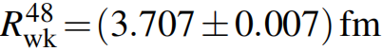
Statistical Uncertainties
Your Title Here SYSU
Statistical uncertainties: originate from the finite precision with which a given set of model parameters are calibrated to existing experimental data.
predicted: experiment:
²⁰⁸Pb: completely agreement
⁴⁸Ca: lies well out_x0002_side the 1σ range of the CREX measurement
⁴⁰Ar: highly likely be overestimated
Fig3: weak radii from the covariance matrix associated to the FSUGold2 EDF

Slide 11
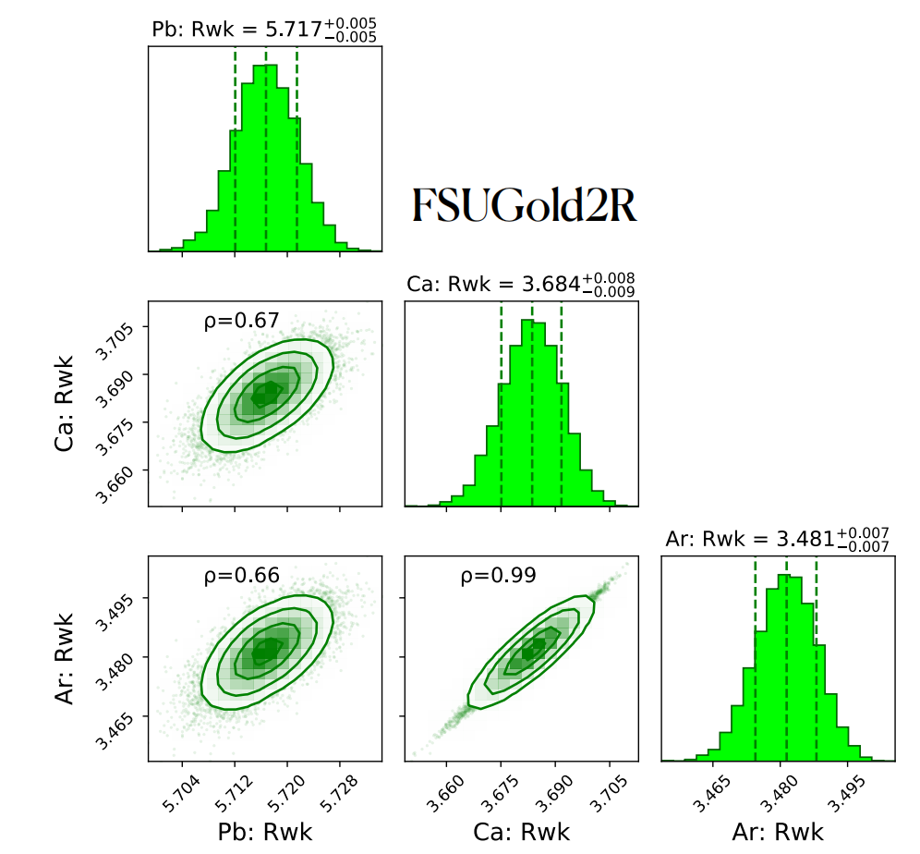
Statistical Uncertainties
the weak radii of three nuclei is smaller
the strong correlation between the weak radii of ²⁰⁸Pb and ⁴⁸Ca is significantly weakened.
the correlation between the weak radii of ⁴⁸Ca and ⁴⁰Ar is strengthened.
the prediction of the weak radii 48Ca by FSUGold2R lies within the 67% confidence interval of CREX
Fig4: weak radii from the covariance matrix associated to the FSUGold2R EDF

Slide 12
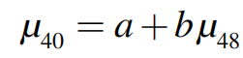

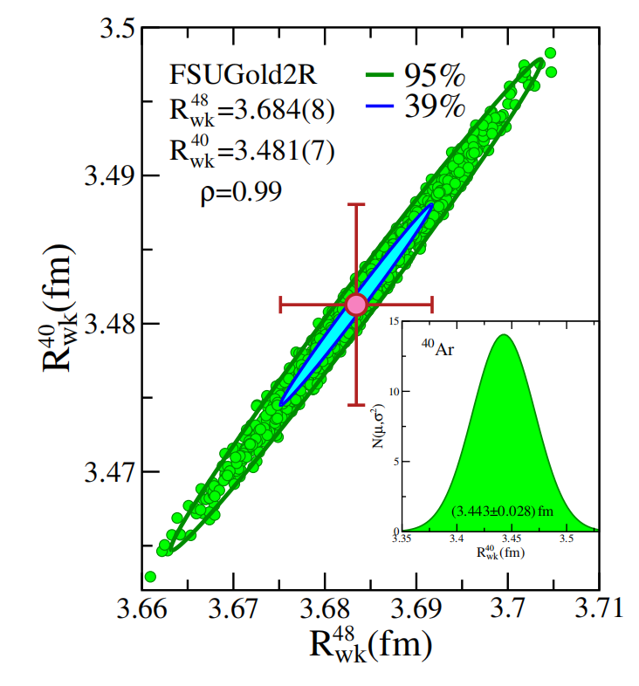
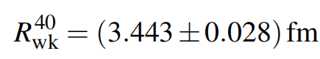
CREX Informing CEνNS
combine the CREX result with the strong correlation displayed by FSUGold2R to predict the weak radius of ⁴⁰Ar.
the correlation between the two weak radii:
the 10,000 MCMC samples drawn from the multivariate normal distribution obtained from the FSUGold2R calibration
reduce model dependence by invoking only the strong correlation between the two weak radii
Fig5: Joint posterior for the weak radii of ⁴⁸Ca and ⁴⁰Ar obtained from 10,000 MCMC samples drawn from the FSUGold2R calibration

Slide 13
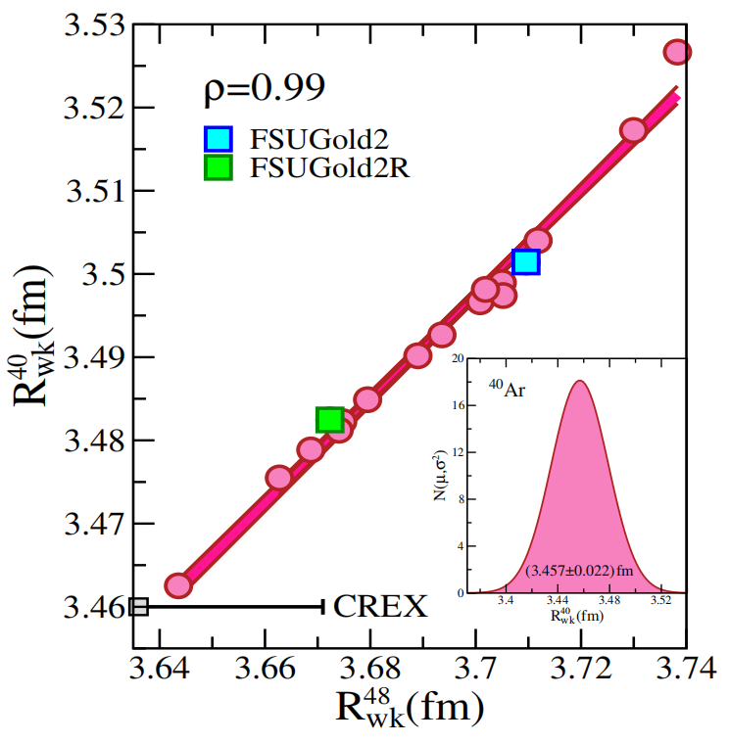
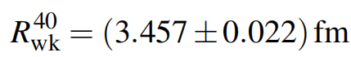
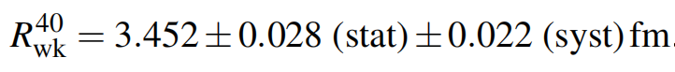
Systematic Uncertainties
Consider 17 covariant energy density functionals to estimate the linear dependence between the weak radii of calcium and argon
the correlation coefficient reveals a strong linear dependence between the two observables
use inverse-variance weighting of the statistical
and systematic results:
Fig6: the weak radii of ⁴⁸Ca and ⁴⁰Ar as predicted by the 17 covariant EDFs

Slide 14
SYSU 2023
PRESENTATION SLIDE
04
Conclusion

Slide 15
Conclusion
Because of the CREX-PREX dilemma, there is no theory model reproducing the mesurement of the weak radii of ²⁰⁸Pb and ⁴⁸Ca, making the prediction of the weak radius of ⁴⁰Ar unreliable.
reduced the reliance on absolute model predictions by invoking the CREX measurement and the correlation between ⁴⁸Ca and ⁴⁰Ar
statistical uncertainty
FSUGold2R
systematical uncertainty
17 EDFs
Relying on the correlation between ⁴⁸Ca and ⁴⁰Ar, the following CREX-informed estimate was obtained

Slide 16
To be improved
A genuine systematic study would include multiple families of energy-density functionals—both relativistic and nonrelativistic, while all results presented were obtained with a single class of covariant energy density functionals.
Second, unlike ⁴⁸Ca and ²⁰⁸Pb, ⁴⁰Ar is not doubly magic, so pairing correlations may be important for the weak radius.
electroweak spin-orbit currents are known to modify both charge and weak radii in nuclei with unpaired spin-orbit partners, which plays different part in ⁴⁸Ca and ⁴⁰Ar.

Slide 17

谢谢观看
冯仟潞
Notes:
幻灯片制作：中山大学党委宣传部 陈柏辰
幻灯片内置的所有示例图片、手绘建筑元素版权归中山大学党委宣传部和供稿人所有，不得移作他用。

